Slide 1
Software Cost Estimation

Slide 2










Software Project Planning
The overall goal of project planning is to establish a pragmatic strategy for controlling, tracking, and monitoring a complex technical project.
Why?
So the end result gets done on time,
with quality!

Slide 3



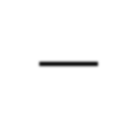











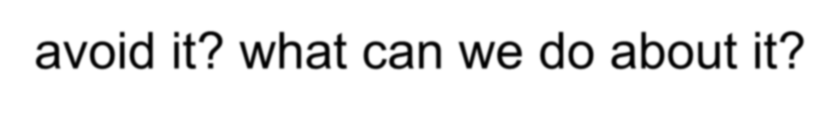

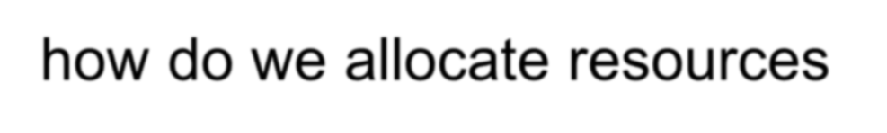



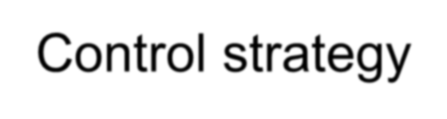
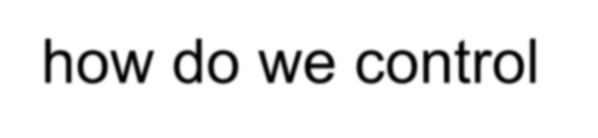
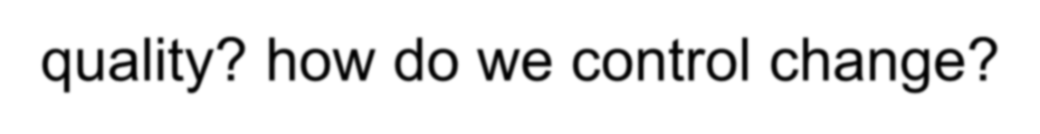

The Steps
Scoping—understand the problem and the work that must be done
Estimation—how much effort? how much
time?
Risk—what can go wrong? how can we avoid it? what can we do about it?
Schedule—how do we allocate resources along the timeline? what are the milestones?
Control strategy—how do we control quality? how do we control change?

Slide 4











To Understand Scope ...
Understand the customers needs understand the business context understand the project boundaries understand the customer’s motivation understand the likely paths for change understand that ...
Even when you understand, nothing is guaranteed!

Slide 5











Write it Down!
Project Scope Estimates Risks Schedule
Control strategy
Software Project Plan

Slide 6
Defect Removal Efficiency
DRE = E /(E + D)
where:
E is the number of errors found before delivery of the software to the end-user
D is the number of defects found after delivery.

Slide 7
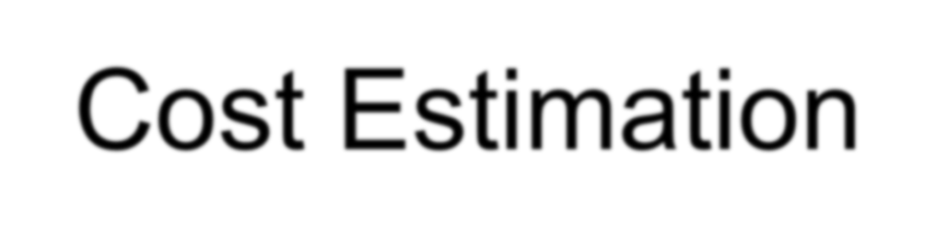















Cost Estimation
project scope must be explicitly
defined
task and/or functional decomposition is necessary
historical measures (metrics) are
very helpful
at least two different techniques should be used
remember that uncertainty is inherent

Slide 8

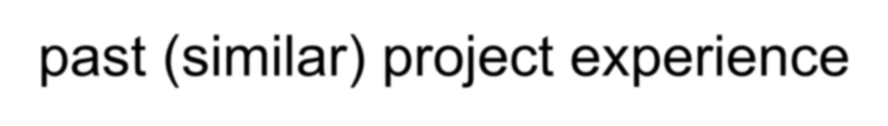



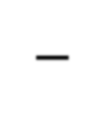

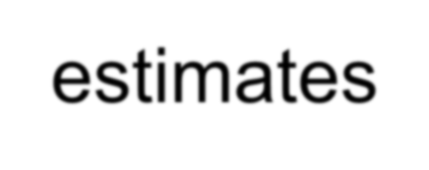


Estimation Techniques
past (similar) project experience conventional estimation techniques
task breakdown and effort estimates
size (e.g., FP) estimates
tools

Slide 9










Functional Decomposition
S
functional decomposition
tatement of Scope
perform
a "grammatical
parse"

Slide 10



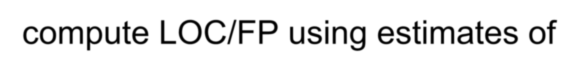


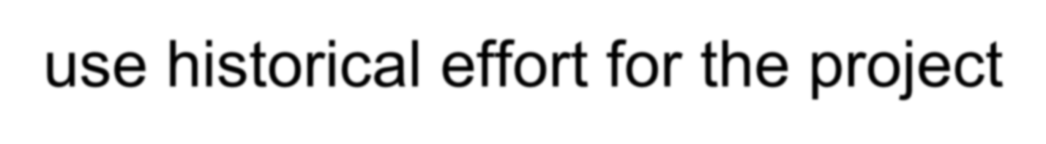
Conventional Methods: LOC/FP Approach
compute LOC/FP using estimates of information domain values
use historical effort for the project

Slide 11
Comparing LOC and FP
Representative values developed by QSM

Slide 12

Example: LOC Approach
Functions | e stimate d LOC | LOC/pm | $/LOC | Cost | Effort (months)
UICF | 2340 | 315 | 14 | 32,000 | 7.4
2DGA | 5380 | 220 | 20 | 107,000 | 24.4
3DGA | 6800 | 220 | 20 | 136,000 | 30.9
DSM | 3350 | 240 | 18 | 60,000 | 13.9
CGDF | 4950 | 200 | 22 | 109,000 | 24.7
PCF | 2140 | 140 | 28 | 60,000 | 15.2
DAM | 8400 | 300 | 18 | 151,000 | 28.0
Totals | 33,360 |  |  | 655,000 | 145.0

Slide 13


Example: FP Approach
measurement parameter
count
weight
number of user inputs | 40 | x | 4 | = | 160
number of user outputs | 25 | x | 5 | = | 125
number of user inquiries | 12 | x | 4 | = | 48
number of files | 4 | x | 7 | = | 28
number of ext.interfaces | 4 | x | 7 | = | 28
algorithms | 60 | x | 3 | = | 180
0.25 p-m / FP
= 120 p-m
count-total
569
complexity multiplier
.84
feature points
478

Slide 14














Creating a Task Matrix
Obtained from “process framework”
 | framework activities
application functions | Effort required to accomplish each framework activity for each application function

Slide 15
Process-Based Estimation Example
Based on an average burdened labor rate of $8,000 per month, the total estimated project cost is $368,000 and the estimated effort is 46 person-months.

Slide 16
Tool-Based Estimation
project characteristics
calibration factors
LOC/FP data

Slide 17

Empirical Estimation Models
General form:
exponent
effort = tuning coefficient * size
usually derived
as person-months of effort required
empirically derived
usually LOC but may also be function point
either a constant or
a number derived based on complexity of project

Slide 18
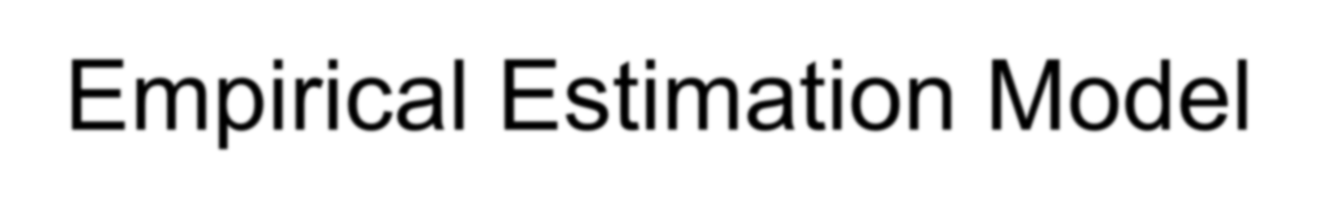
Empirical Estimation Model
LOC-Oriented Estimation models
E = 5.2 X( KLOC) ^{.91}
E = 5.5 + 0.73 X ( KLOC)^{1.16} E = 3.2 X (KLOC) ^{1.05}
Waltson-Felix Model Bailey-Basili model Boehm Simplw Model
FP-Oriented Estimation models
E = -13.39 X .0545 FP
E = 60.62 X 7.728 X 10-8 FP³
E = 585.7 X 15.12 FP
Albrecht and Gaffney Model
Kemerer model
Matson, Barnett, and Mellichamo Model

Slide 19
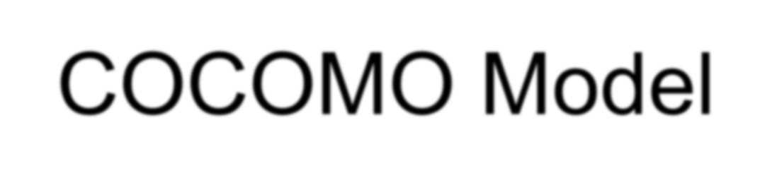
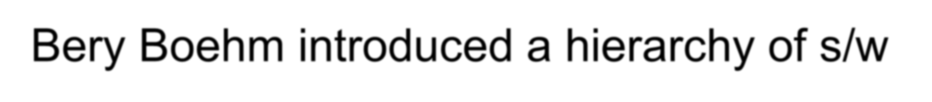

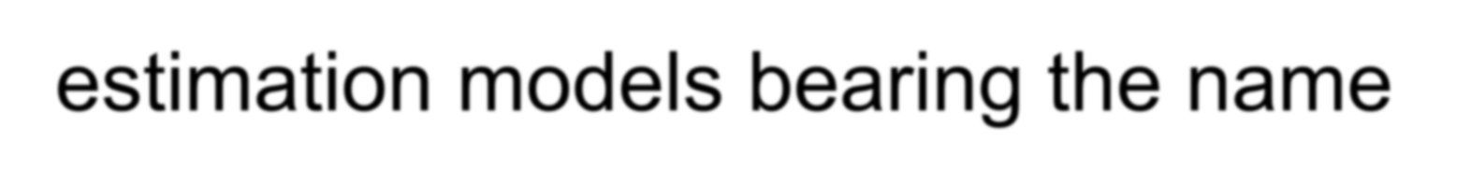
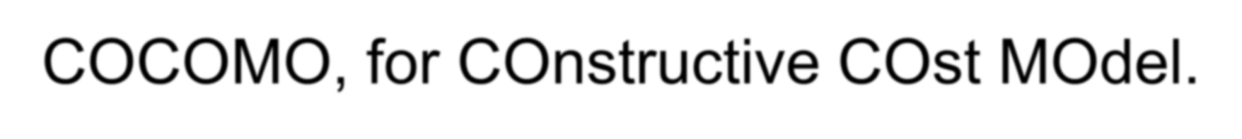


COCOMO Model
Bery Boehm introduced a hierarchy of s/w estimation models bearing the name COCOMO, for COnstructive COst MOdel.
See :
sunset.usc.edu/COCOMOII/cocomo.html

Slide 20

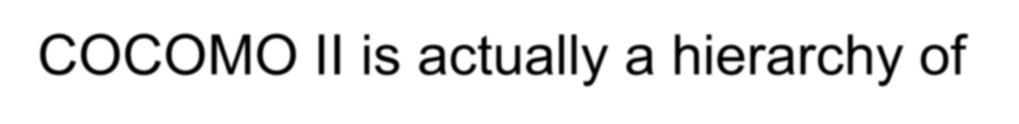


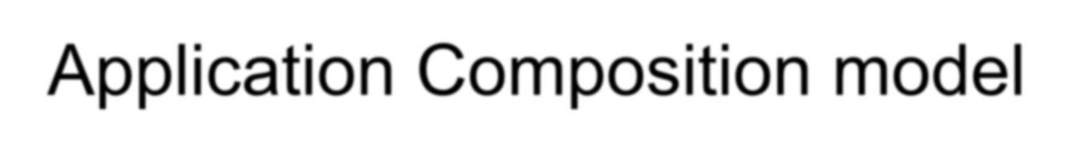



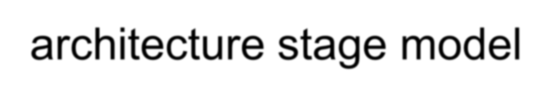
COCOMO II
COCOMO II is actually a hierarchy of estimation models that address the following areas:
Application Composition model Early Design Stage Model Post-architecture stage model

Slide 21
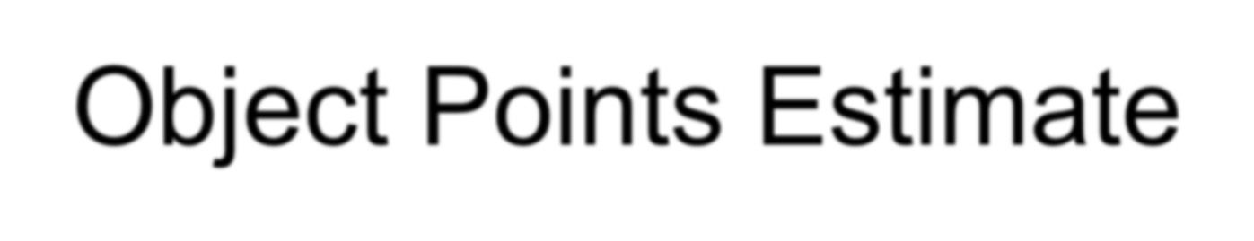

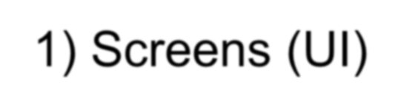
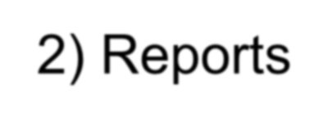
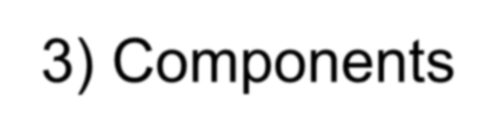
Object Points Estimate
COCOMO II application composition model uses object points
Like Function Points, the Object Point is an indirect s/w measure that is computed using counts of number of:
Screens (UI)
Reports
Components

Slide 22


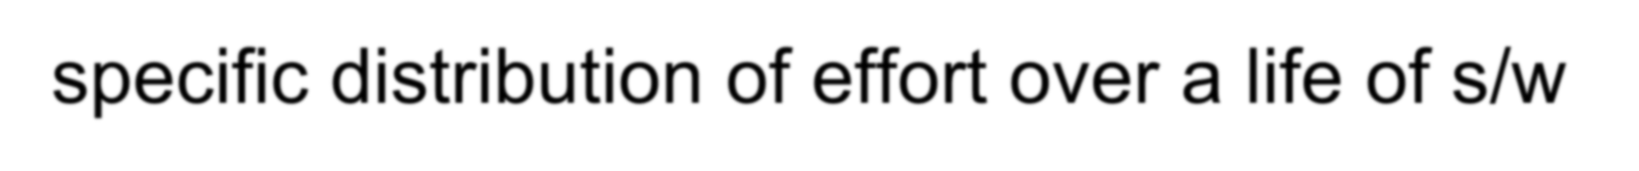
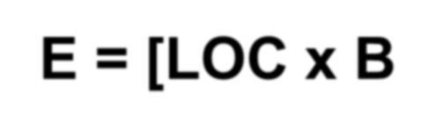

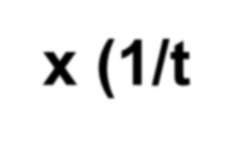
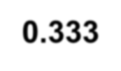
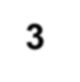


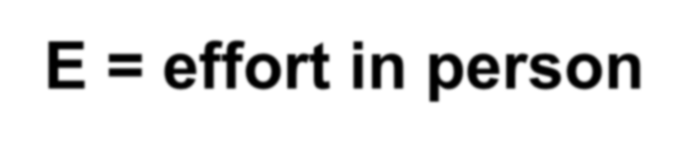



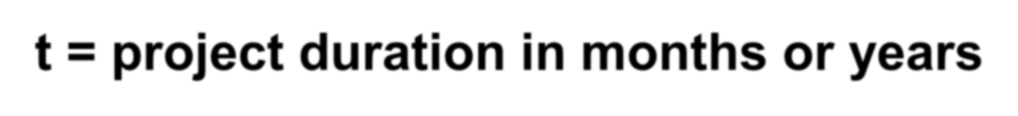
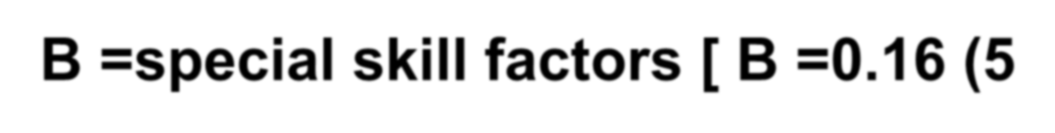
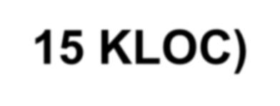
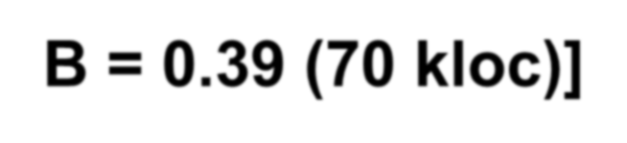
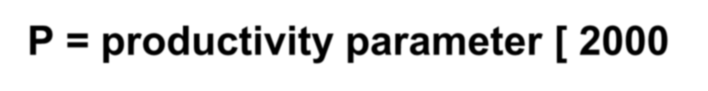
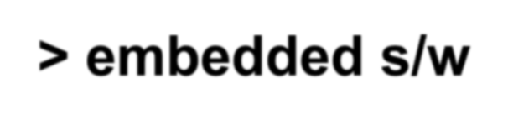

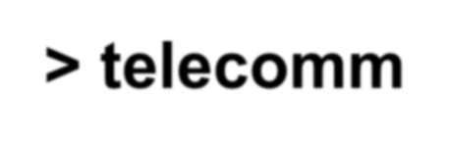
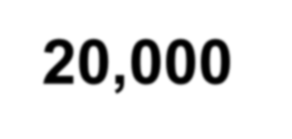
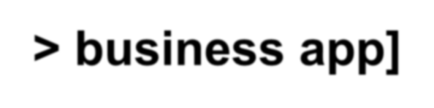
The Software Equation
It is a dynamic multivariable model that assumes a specific distribution of effort over a life of s/w development of project. [from 4000 s/w projects]
E = [LOC x B^{0.333} /P ] ³ x (1/t⁴)
E = effort in person-months/person-years t = project duration in months or years
B =special skill factors [ B =0.16 (5-15 KLOC)
B = 0.39 (70 kloc)]
P = productivity parameter [ 2000 -> embedded s/w
10,000 -> telecomm 20,000 -> business app]

Slide 23














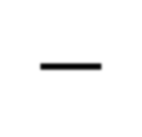

Estimation Guidelines
estimate using at least two techniques
get estimates from independent sources avoid over-optimism, assume difficulties you've arrived at an estimate, sleep on it
adjust for the people who'll be doing the job—they have the highest impact

Slide 24



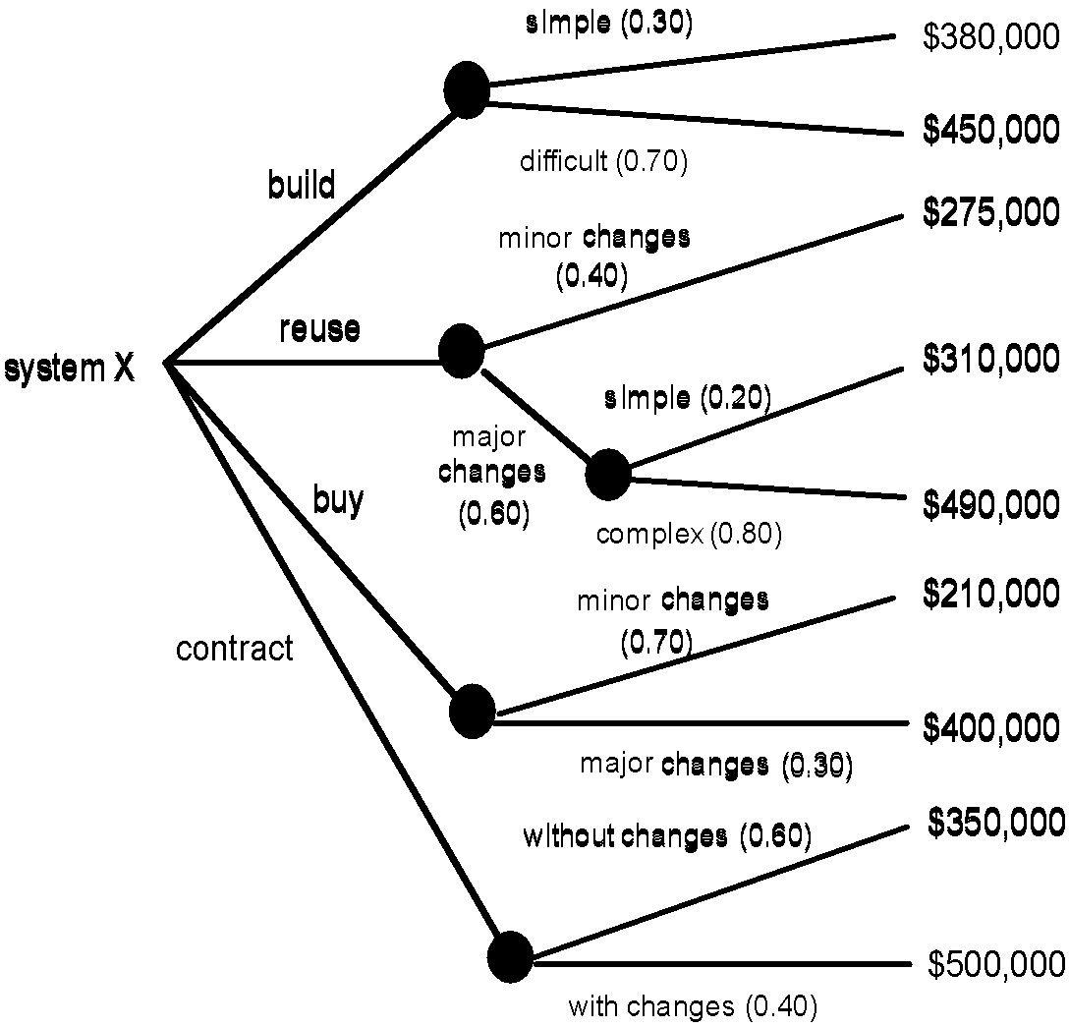
The Make-Buy Decision

Slide 25
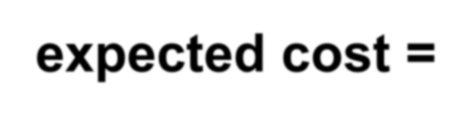

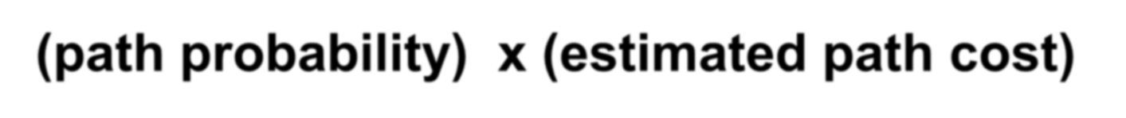



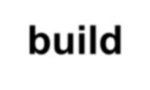
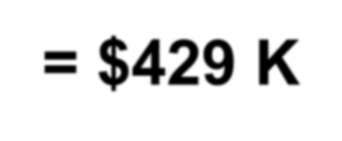







Computing Expected Cost
expected cost =
(path probability) _{i} x (estimated path cost) _{i}
For example, the expected cost to build is:
expected cost_{build} = 0.30($380K)+0.70($450K)
= $429 K
similarly,
expected cost _{reuse} expected cost _{buy} expected cost _{contr}
= $382K
= $267K
= $410K

